Slide 1
Document
Store
Question
Answer
https://www.goldmansachs.com/intelligence/pages/how-generative-ai-tools-are-changing-systematic-investing.html
Our investment process and signal research has evolved closely alongside the latest in data and quantitative techniques. Many of the valuable data sets we leverage today are larger, less structured, and generally more complex in nature relative to what was previously available. This also means they require more robust tools and techniques to analyze. Think in terms of financial news articles, earnings call transcripts, analyst research reports, regulatory filings. As technologies progressed over the years, we were able to benefit from the exponential growth of data and start using more unstructured data.
Dennis Walsh, global co-head, Quantitative Investment Strategies, Goldman Sachs Asset Management.
https://www2.deloitte.com/content/dam/Deloitte/th/Documents/deloitte-consulting/generative-AI-dossier.pdf
A Generative-AI-enabled virtual field assistant can serve as a reference tool and provide quick access to a vast amount of technical information. In addition to delivering relevant information and directing engineers to appropriate resources, a virtual field assistant can help with problem-solving by responding to questions about specific engineering concepts, principles, or calculations.
https://www.ey.com/en_us/insights/insurance/how-insurers-can-leverage-the-power-of-generative-ai
Efficiency benefits include summarizing and synthesizing large volumes of content gathered during the claims lifecycle, including call transcripts, notes, and legal and medical paperwork, which is particularly useful in property and casualty insurance. Companies can compress the claims lifecycle dramatically. Particularly in the life insurance industry, there is significant interest in using generative AI for automation and decision-making in underwriting processes and policy issuance to a broader range of customers without the need for, say, in-person medical exams.
Ernst & Young

Slide 2
Document
Store
Question
Answer

Slide 3
Retrieval-augmented generation (RAG)
Retrieval-augmented generation (RAG) is a technique that enhances generative AI models by incorporating external data sources to improve accuracy and relevance in text generation
Indexing
Data
/
Documents
Vector DB
Chunker
Chunks
LLM
Querying
Query
Retriever
Reader
Response
Chunks

Slide 4
Input documents are split into chunks of a certain size.
User Query
The vector database is pre-populated by indexing all the document chunks and the vectors created using the embedding. Indexes are organized into collections.
Input Documents
Documents
Embedding Model
Embeddings
Similar Documents
Each chunk is associated with a vector.
VectorDB

Slide 5
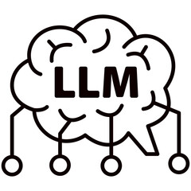
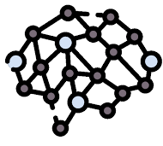


Multimodal Retrieval-augmented generation (MMRAG)
Data Source
Parse text
Text Data
Multimodal embedding model
Large language model
Text
Text
Vector DB
Text
Vector
Summary
content
parsing
image
Generation
Table
Table Summary
Table content/location
Text
Raw text
Similarity search
Answer
Vector
Embedding
Image/Chart
Visual Language Model
location
Image Captioning Text
Similarity Search
Object Store
Caption
Text
Query
Image Captioning
Reasoning and Retrieval
Raw data
Raw Image Data
Architecture - Pipeline

Slide 6

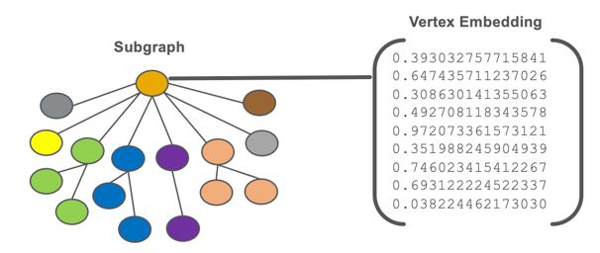

Slide 7





Documents
similarity
search on
Embeddings
1 0 0 11 0 0 1 1 0 0 1 1 0 0 1 1 0 0 1 1 0 0 11 0 0 1 1 0 0 1 1 0 0 1 1 0 0 1 1 0 0 11 0 0 1 1 0 0 1 1 0 0 1 1 0 0 1 1 0 0 11 0 0 1 1 0 0 1 1 0 0 1 1 0 0 11 0 0 11 0 0 1 1 0 0 1 1 0 0 1 1 0 0 1 1 0 0 11 0 0 1
Embedding
Model
Gradio + Python
generates
Vector ChromaDB
To retrieve
presented to
Query text
USER
>>>
response
Doc1
Doc2
Doc n
Doc3
Doc
(n-1)
Relevant Document Chunks

Slide 8
https://www.goldmansachs.com/intelligence/pages/how-generative-ai-tools-are-changing-systematic-investing.html
Our investment process and signal research has evolved closely alongside the latest in data and quantitative techniques. Many of the valuable data sets we leverage today are larger, less structured, and generally more complex in nature relative to what was previously available. This also means they require more robust tools and techniques to analyze. Think in terms of financial news articles, earnings call transcripts, analyst research reports, regulatory filings. As technologies progressed over the years, we were able to benefit from the exponential growth of data and start using more unstructured data.
Dennis Walsh, global co-head, Quantitative Investment Strategies, Goldman Sachs Asset Management.
https://www2.deloitte.com/content/dam/Deloitte/th/Documents/deloitte-consulting/generative-AI-dossier.pdf
A Generative-AI-enabled virtual field assistant can serve as a reference tool and provide quick access to a vast amount of technical information. In addition to delivering relevant information and directing engineers to appropriate resources, a virtual field assistant can help with problem-solving by responding to questions about specific engineering concepts, principles, or calculations.
https://www.ey.com/en_us/insights/insurance/how-insurers-can-leverage-the-power-of-generative-ai
Efficiency benefits include summarizing and synthesizing large volumes of content gathered during the claims lifecycle, including call transcripts, notes, and legal and medical paperwork, which is particularly useful in property and casualty insurance. Companies can compress the claims lifecycle dramatically. Particularly in the life insurance industry, there is significant interest in using generative AI for automation and decision-making in underwriting processes and policy issuance to a broader range of customers without the need for, say, in-person medical exams.
Ernst & Young

Slide 9
RAG
Context + Text
Text
Context + Question
Answer
Contextualized

Slide 10


Indexing
context length (512 tokens for gte-large)
1 0 0 11 0 0 1 1 0 0 1 1 0 0 1 1 0 0 1 1 0 0 11 0 0 1 1 0 0 1 1 0 0 1 1 0 0 1 1 0 0 11 0 0 1 1 0 0 1 1 0 0 1 1 0 0 1 1 0 0 11 0 0 1 1 0 0 1 1 0 0 1 1 0 0 11 0 0 11 0 0 1 1 0 0 1 1 0 0 1 1 0 0 1 1 0 0 11 0 0 1
Chunks
Embedding
Chunker
companies+”data-10-k-2023.pdf
Vector ChromaDB
Querying
Chunks
Gradio + Python
reader
USER
retriever
response
RAG – Retrieval-augmented generation (RAG) is a technique that enhances generative Al models by incorporating external data sources to improve accuracy and relevance in text generation

Slide 11
Each chunk is associated with a vector.
Documents
User Query
Input Documents
Embedding Model
Embeddings
Similar Documents
Input documents are split into chunks of a certain size.
VectorDB
The vector database is pre-populated by indexing all the document chunks and the vectors created using the embedding. Indexes are organized into collections.

Slide 12
camera
Pre-trained using masked language modeling, that is, predicting the masked word in a sentence.
issues
Embedding Model
problems
glitches
Raw 2D Mathematical Space
Each word is associated with a random list of two numbers. Words with similar meanings are scattered
issues
glitches
camera
problems
Contextualised 2D Mathematical Space
Each word is associated with a specific list of two numbers. Words with similar meaning are clustered close to each other

Slide 13
sentence2
Pre-trained using masked language modelling. A special token ([CLS]) is added to the beginning of each sentence during training.
sentence4
Embedding Model
sentence3
sentence1
Raw 2D Mathematical Space
Each sentence is associated with a random list of two numbers. Sentences with similar meanings are scattered
sentence3
sentence2
sentence4
sentence1
Contextualized 2D Mathematical Space
Each sentence is associated with a specific list of two numbers. Sentences with similar meaning are clustered close to each other

Slide 14
File
512
512
512
512
512
16
16
16
16
Overlapping Chunking

Slide 15
Documents
similarity
search on
Embeddings
1 0 0 11 0 0 1 1 0 0 1 1 0 0 1 1 0 0 1 1 0 0 11 0 0 1 1 0 0 1 1 0 0 1 1 0 0 1 1 0 0 11 0 0 1 1 0 0 1 1 0 0 1 1 0 0 1 1 0 0 11 0 0 1 1 0 0 1 1 0 0 1 1 0 0 11 0 0 11 0 0 1 1 0 0 1 1 0 0 1 1 0 0 1 1 0 0 11 0 0 1
Embedding
Model
Gradio + Python
generates
Vector ChromaDB
To retrieve
presented to
Query text
USER
>>>
response
Doc1
Doc2
Doc n
Doc3
Doc
(n-1)
Relevant Document Chunks

Slide 16
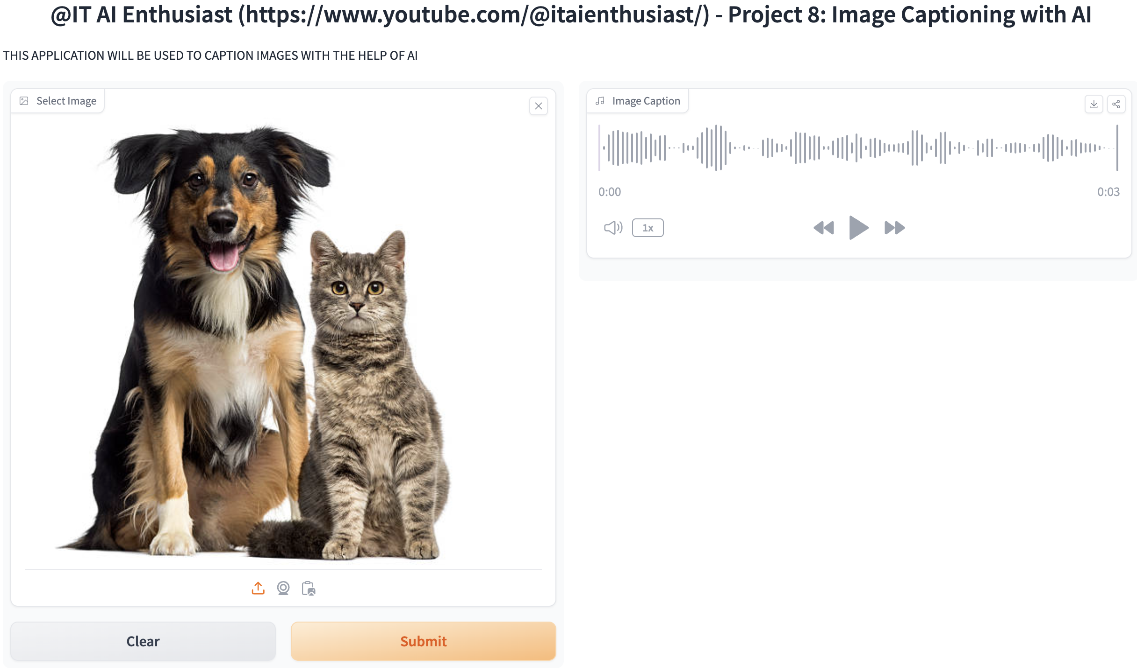
CICD Automation - HuggingFace
Gradio UI
repository
app.py
API
Build
requirements.txt
-> Docker image created and pushed -> Install requirements
CICD:
Whenever changes have been made, a new build happens automatically.
Logs

Slide 17

Creating and Deploying on Huggingface
Gradio UI + logic implementation on Python
2
Import Libraries
app.py
Huggingface Space
requirements.txt
1
List of all the package version dependencies needed.

Slide 18
CICD Automation for RAG on HuggingFace
repository
Gradio UI
Vector DB
app.py will run LLM on anyscale
app.py
Build
API
requirements.txt
-> Docker image created and pushed -> Install requirements
LLM on AnyScale
CICD:
Whenever changes have been made, a new build happens automatically.
Logs

Slide 19
Creating and Deploying - RAG on Huggingface
Create
VectorDB
Build
RAG
Gradio UI + logic implementation on Python
Chunk
Data
Evaluate
Import Libraries
app.py
Huggingface Space
requirements.txt
Persisted VectorDB
List of all the package version dependencies needed.

Slide 20
Generative AI
Potential Risks
Guardrails
Misinformation
Ethical Guidelines
Bias
Data Management
IP Issues
Testing & Validation
Privacy Concerns
User Education
Security Risks
Regulatory Frameworks

Slide 21
Developers
Innovation
AI Development
Policymakers
Regulation
Responsible AI
Society
Adoption

Slide 22
Upload Image
Object Detection flow
Object Detection & covert into speech flow
Legends
Object Detector
facebook/detr-resnet-50
draw_bounding_boxes
Output image with objects highlighted
read_object
Text to Speech
Models-kakao-enterprise- -vits-ljs
Audio description

Slide 23
Upload Image
Object Detection – Image-to-Text Description
Text to audio into speech flow
Legends
Object Detector
Salesforce/blip-image-captioning-large
Output image-to-text description about image
read_object
Text to Speech
Models-kakao-enterprise- -vits-ljs
Audio description

